Slide 1
2022 Special CoC NOFO Competition Info & Q&A Session
07/14/2022
Via Microsoft Teams

Slide 2
SLC CoC Local Competition Materials
All local Materials can be found here
Timeline pending:
This will align with traditional NOFO calendar as much as possible
Review Supplemental Application (pending approval)
All applicants must complete the HUD eSnaps & supplemental application
Review Score Tool (pending approval)
Score tool & application may still have changes based on Planning & Eval Committee & HHAC/CoC Governing board feedback
Review Ranking & Review Policy

Slide 3
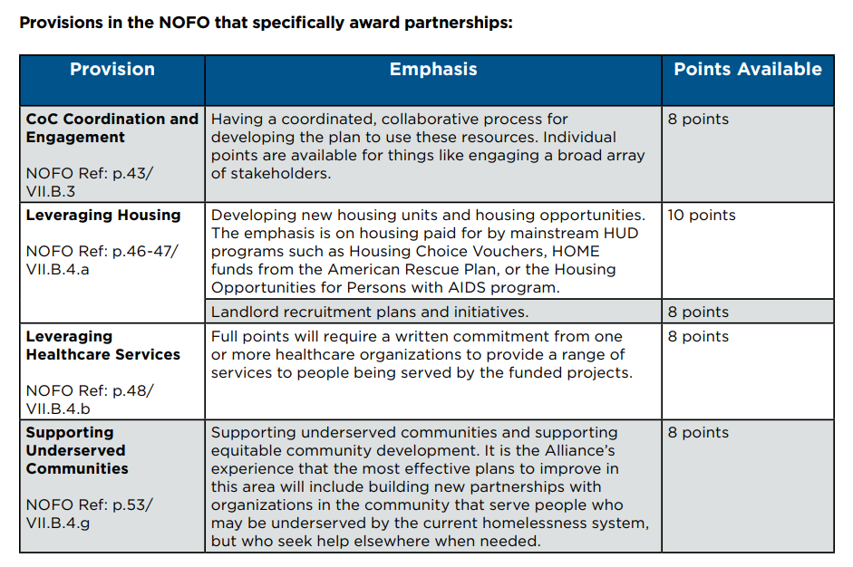
2022 HUD Priorities
Reducing unsheltered homelessness
Reducing Rural Homelessness
Projects on tribal lands
Housing First Approach
Involving a broad array of stakeholders
Advancing equity
Notes:
Image source: 2022SupplementalNOFO-FactSheets-Partnerships-updated.pdf (endhomelessness.org)

Slide 4
Rural Set aside: $10,115/3 years
This is the total funding amount eligible for 3 years
For this NOFO, only projects located on Bois Forte Tribal lands are eligible for Rural set aside
Permanent Housing-Permanent Supportive Housing Projects for chronically homeless at program entry
Permanent Housing-Rapid Rehousing Projects for people who qualify as homeless
Joint Transitional Housing and Rapid Rehousing Component Projects for people who qualify as homeless
Supportive Services Only Projects

Slide 5
Unsheltered Set Aside: $4, 129,591/3 years
No guarantee SLC CoC will be awarded funds in this process
Cannot fund emergency shelter projects
Any NEW project in the CoC that targets unsheltered homelessness
PSH projects include: PSH, RRH, or Joint TH-RRH Projects or Support Service Only (including Street Outreach Grants)
SSO-Coordinated Entry Grants & HMIS grants eligible as well
Planning grants for CoCs (cannot exceed more then 3 percent of total CoC Award)
All grants will have 3 year terms, with up to 5 years for execution. As long grant terms are met, grants will roll into Annual Renewal Demand for SLC CoC.

Slide 6
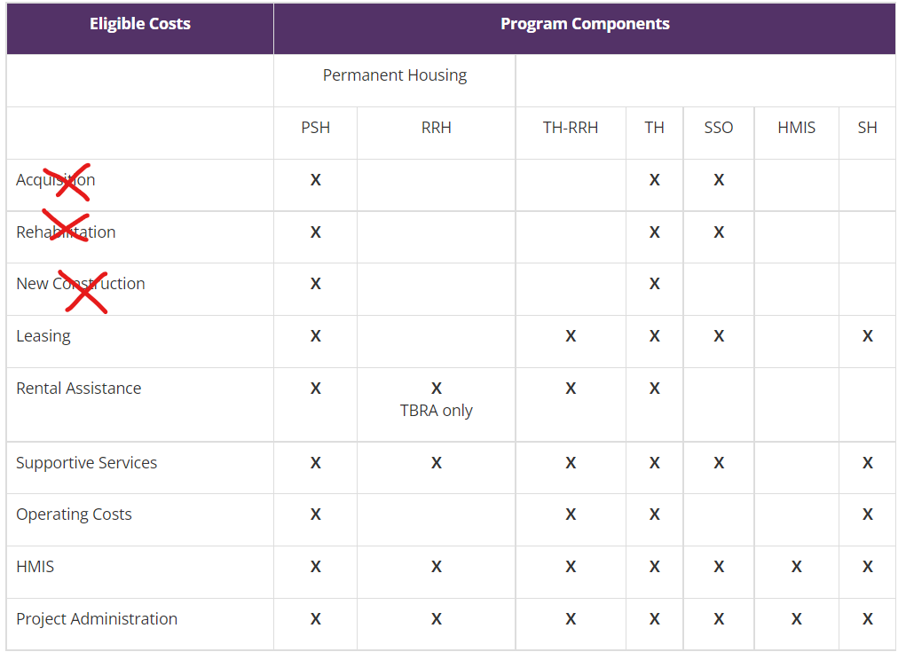
More on eligible costs for Unsheltered set aside
All the usual CoC eligible expenses such as support services, admin, rent payment, etc. (detailed in CoC Program Rule 24 CFR 578), except for acquisition, new construction, or rehabilitation costs.
Please review details of each eligible cost here
Notes:
The eligible costs that HUD will fund under the Unsheltered Homelessness Set Aside through this Special NOFO can be found in Section V.B.3.e. of the NOFO. They are all of the costs established in Sections 578.37 through 578.63 of the CoC Program interim rule, except that costs for acquisition, new construction, or rehabilitation will NOT be funded through the Unsheltered Homelessness Set Aside.

Slide 7
Unsheltered Set Aside Project Scoring
Up to 50 points awarded to Projects based on CoC Collaborative Application Score
This entails a 15 page intensive narrative on our CoC plan to end unsheltered homelessness
This will take community collaboration to pull together and score high enough to be competitive
All project applications must line-up with this plan to be eligible
Up to 40 points based on CoC Project Ranking
Up to 10 points for serving structurally disadvantages areas.
CoC bonus for high PIT count of unsheltered population (up to 30 points), SLC CoC is eligible for 0/30 points in HUD unsheltered bonus
Projects will need MOUs from PHAs/Healthcare Orgs/Demonstrating development of New units
Notes:
serving structurally disadvantages areas: geographic areas with high levels of homelessness, housing distress, to poverty, and located where CoC services have never been available

Slide 8
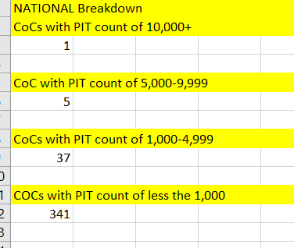
Reality on the Bonus Points
HUD excepts to fund 125 projects total, 43 of which would have bonus funds.
HUD has also announced that for the Unsheltered Set Aside, that funding is considered as a package.
This means we will get all funding or no funding.
Not project-by-project awards.

Slide 9
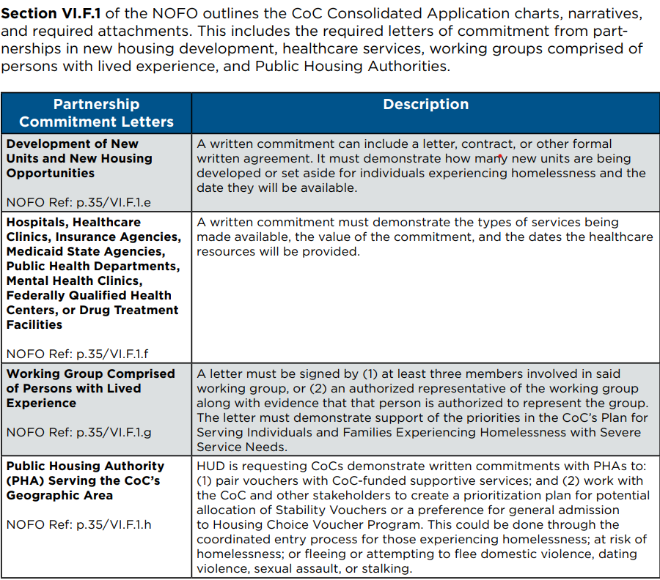
MOUs for unsheltered homelessness set aside
Not every project needs this, but at least one letter from each of below entities is required with the Collaborative Application.
The housing leveraging letter must be attached to a PSH/RRH project
CoC Letter of support & planning engagement required from stakeholder group of those who have been homelessness/are currently homeless.
Projects will be asked to present on project proposals in a community forum, with a turnout focus on those w/lived experience of homelessness.
Notes:
Source for image: 2022SupplementalNOFO-FactSheets-Partnerships-updated.pdf (endhomelessness.org)

Slide 10
Tips for Application
Read through the Full Special NOFO and details of project eligibility
Read through the HUD Detailed Application Instructions (Coming Soon)
Use the eSnaps Navigational Guide (Coming Soon)
HUD Scores each question separately, so repetition is your friend
Double check all attachments
Form 2880 Guidance
Remember the 25% match requirement
Documentation (3rd party only)
Cannot match with other CoC funds or ESG funds
Start early & ask lots of questions!

Slide 11
Helpful Resources
HUD CoC Special NOFO Competition Page
2022 Special HUD CoC NOFO Competition Notice
Appendix B: Rural Community designations (hud.gov)
Appendix A: Maximum Award Amounts Per CoC for the Unsheltered Homelessness Set Aside and the Rural Set Aside (hud.gov)
eSnaps Resources Page
HUD Exchange CoC 101 Page
HUD CoC Program Rule (24 CFR 578)
eSnaps Guide for Creating New Applicant Profile
National Alliance to End Homelessness NOFO Tools & Fact Sheets

Slide 12
Questions?
HUD NOFO specific Questions: SpecialCoCNOFO@hud.gov
eSnaps specific questions: e-snaps@hud.gov
Regular CoC Office Hours: Every Thursday from 11am to 12:30pm Via Teams
Link in comment of slides & on CoC Website
Contact: CoC Coordinator, Courtney Cochran with any questions cochranc@stlouiscountymn.gov or (218) 725- 5158
Notes:
________________________________________________________________________________
Microsoft Teams meeting
Join on your computer or mobile app
Click here to join the meeting
Or join by entering a meeting ID Meeting ID: 259 132 921 351 Passcode: MoPSx5
Join with a video conferencing device
stlouiscountymn@m.webex.com
Video Conference ID: 112 739 229 8
Alternate VTC instructions
Or call in (audio only)
+1 872-242-8850,,60221525# United States, Chicago
Phone Conference ID: 602 215 25#
Find a local number | Reset PIN
Learn More | Meeting options
________________________________________________________________________________

